Slide 1
OrCam – AI for Humans
2020
Oded Tsin, U.S Business Development Manager
Oded.tsin@orcam.com

Slide 2
“I can read, I just can’t see to read”
Mustafa Tyson

Slide 3
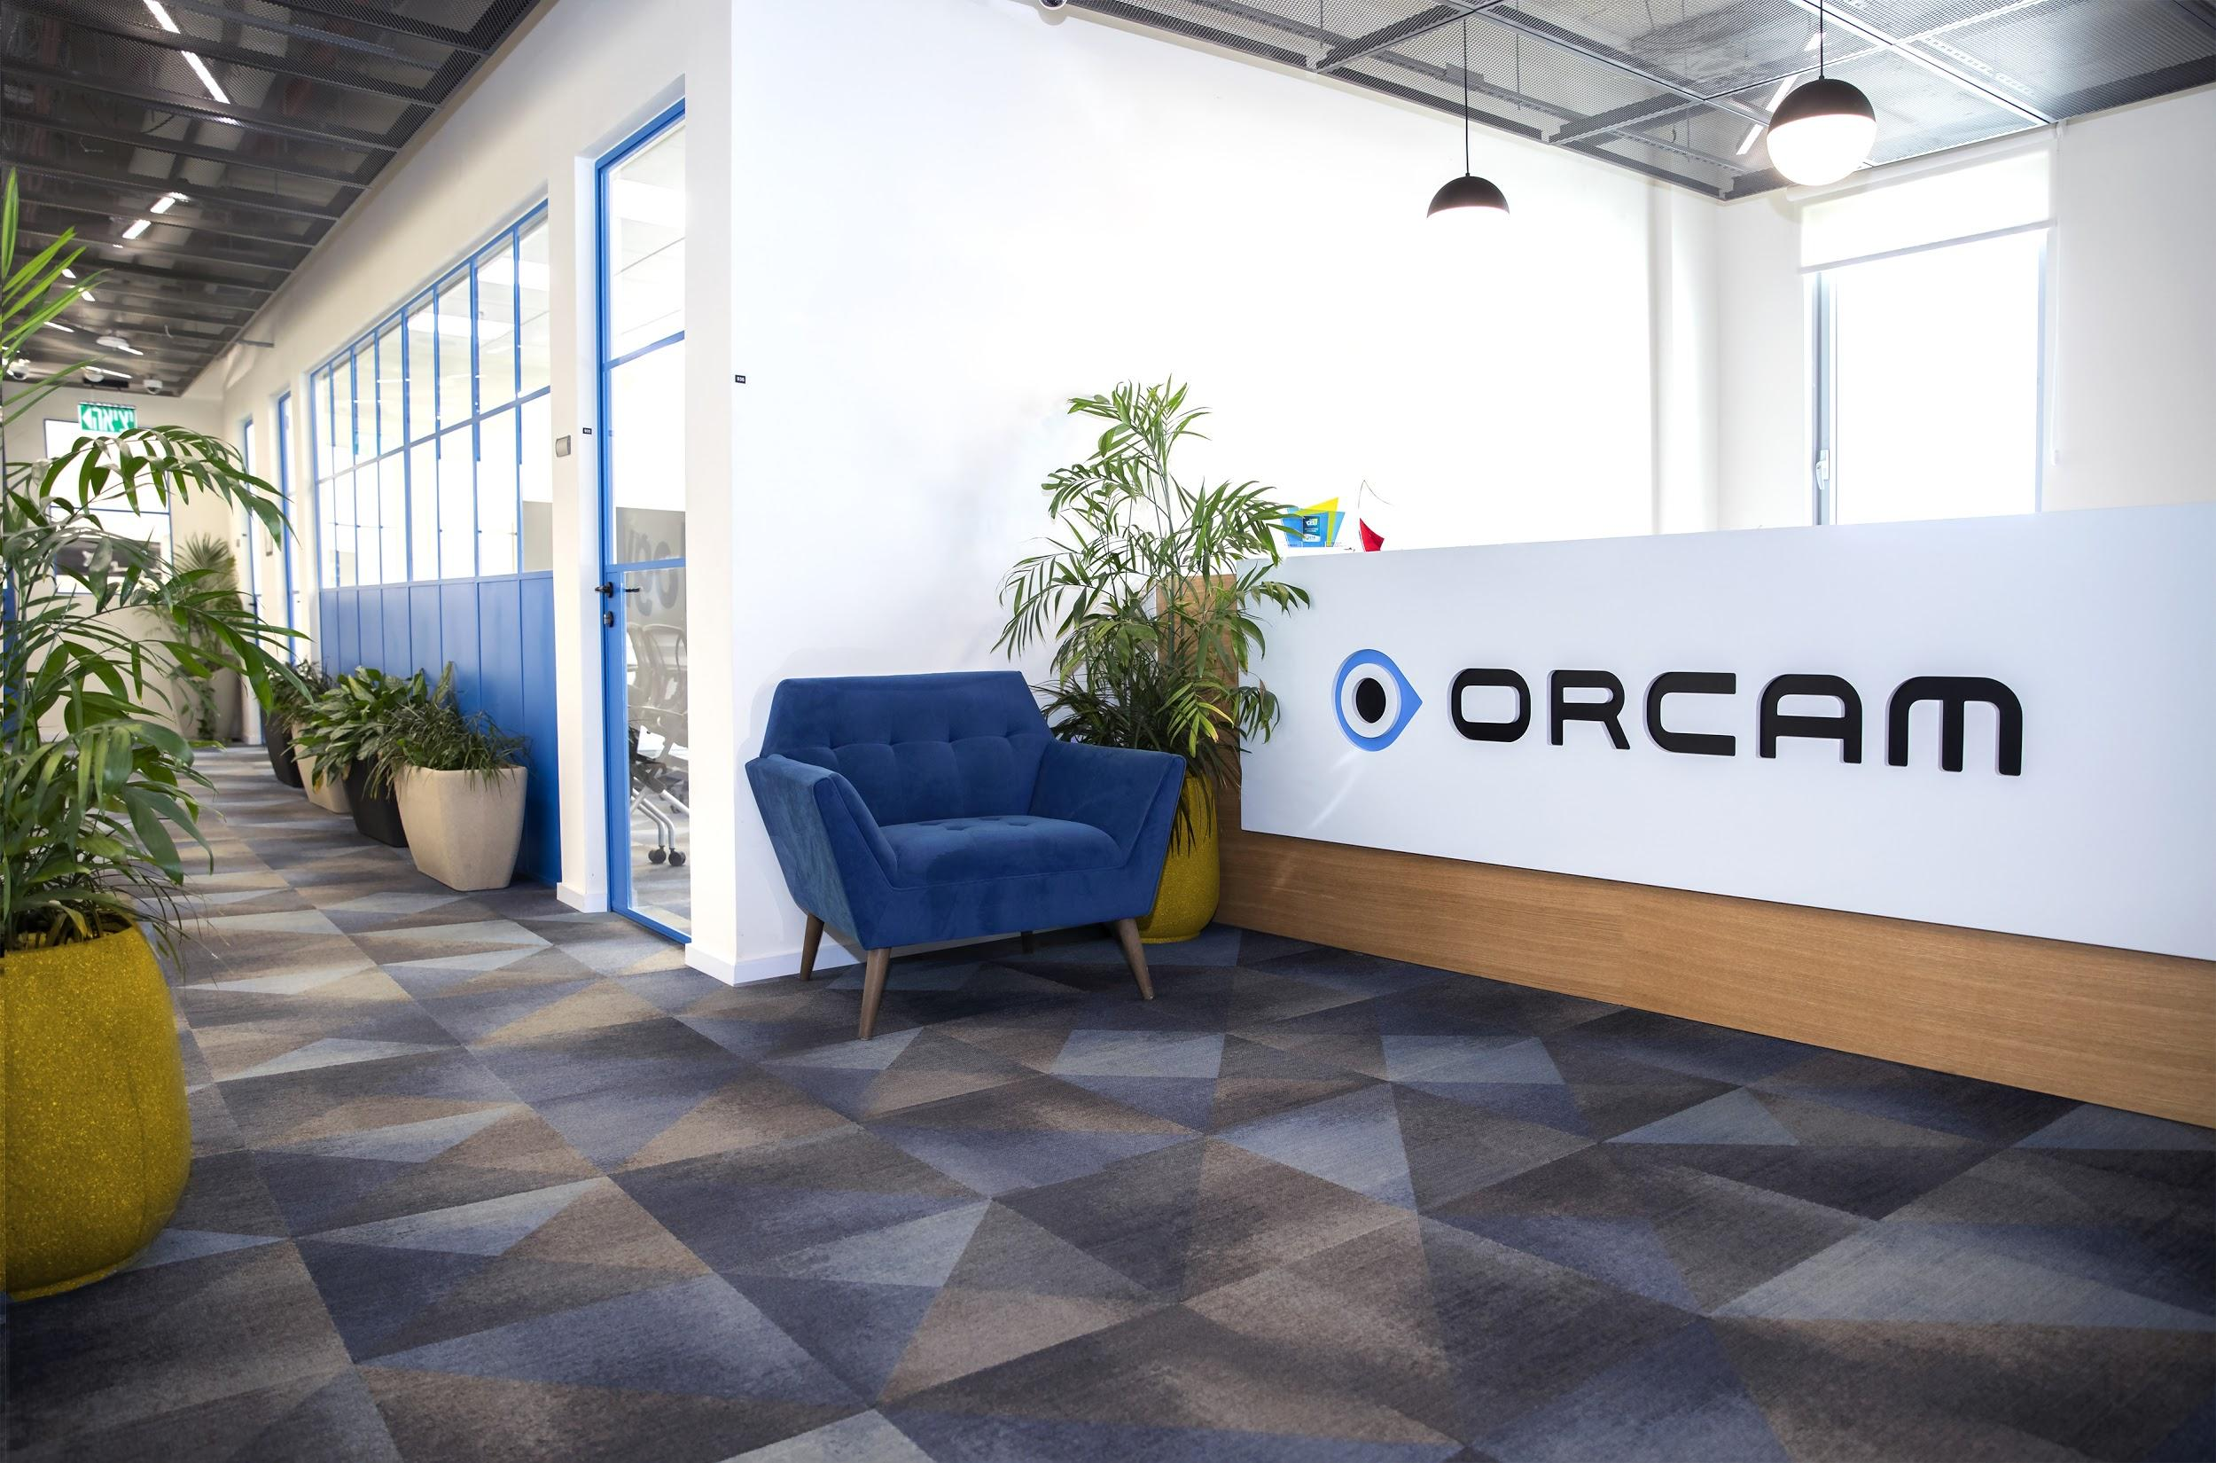
2010
OrCam Technologies founded
2013
OrCam MyEye 1 Beta testing begins
2015
Official launch of OrCam MyEye 1
2017
OrCam MyEye 2 launched
2020
OrCam Read and OrCam MyEye 2 Pro launched
2021
OrCam Hear to be launched
Jointly founded in 2010 by Israeli innovators Dr. Amnon Shashua and Ziv Aviram
Co-founders of Mobileye, the collision avoidance system leader and autonomous driving innovator.
Our Vision.
Empowering People.
Notes:
OrCam was Jointly founded in 2010 by Israeli innovators and Co-CEO’s Dr. Amnon Shashua and Ziv Aviram
Amnon and Ziv Co-founded Mobileye, the collision avoidance system leader and autonomous driving innovator. Which is now become the autonomous driving division at intel.
Inspired by their groundbreaking artificial vision technology that supports safer drivers, they co-founded OrCam with the idea that we can also harness AI-driven computer vision to bring increased independence to people who are blind, visually impaired, or have reading difficulties.
2013,2015,2017 Our Vision. Empowering People.
The thinking behind OrCam's activities is - what we can do to help people? So we are working on developing more products to help more people with a variety of disabilities

Slide 4
Our Mission.
OrCam’s mission is to harness the power of artificial vision by incorporating pioneering technology into wearable and handheld AI-driven platforms which improve quality of life.
Comprised of experts in the Computer Vision and Machine Learning fields, our team strives to provide aids through discreet, mobile and easy-to-use interfaces.

Slide 5
Technologies.
Mobile Hardware
Artificial Intelligence (AI) & Machine Learning
Computer Vision
Natural language processing (NLP)

Slide 6
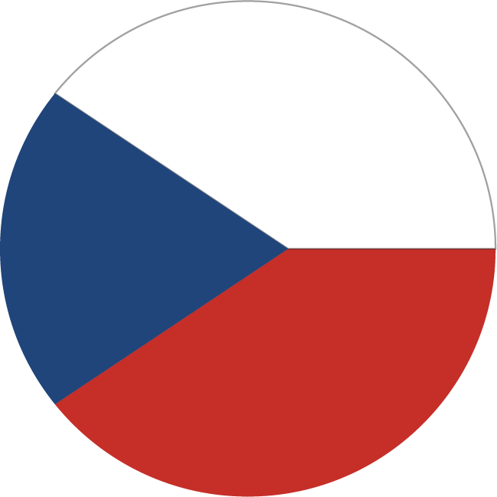
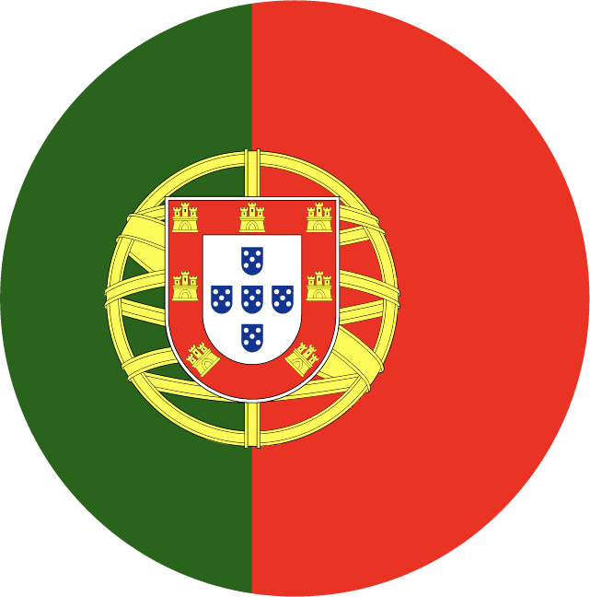
Worldwide Activity.
Until 2018
Q1 2018
25 languages 50 countries
25 languages 50 countries
Q2 2018
Tens of thousands of users all over the world
Q3 2018
Q4 2018
2019

Slide 7
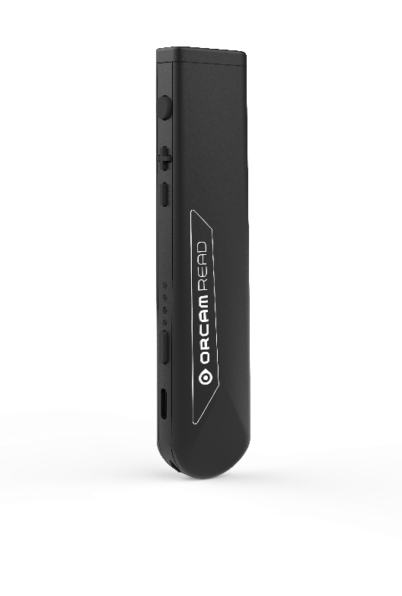
Benefits.
"For most, technology makes things easier, for others, technology makes things possible"
Level the playing field
Access and Time
Flexibility in how, where and what
Independence

Slide 8
OrCam MIX
Seamlessly build a unique assistive tech solution fine-tuned to your customer’s needs.

Slide 9
OrCam Platforms.
Choose what’s right for each user.
| 2020 | Create Your MIX
Notes:
The Choice is Yours.
A Powerful Solution.
Assistive AI unlike Anything Else.
Personal AI Technology. Life-changing Impact.

Slide 10
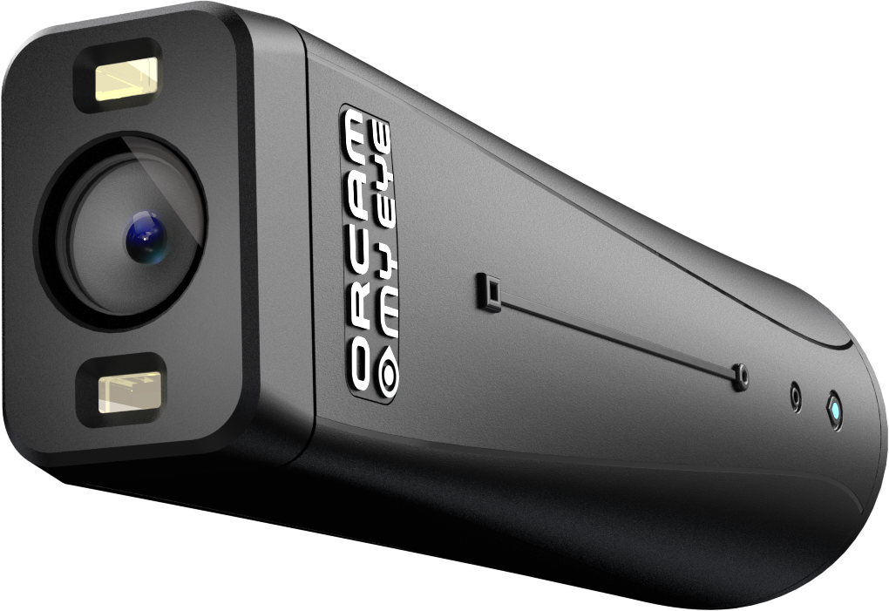
Wearable
OrCam MyEye.
Hands-free independence.
Discreetly fits any glasses frame, voice- and gesture-activated, operates offline & in real time
| 2020 | Create Your MIX
Notes:
The Choice is Yours.
A Powerful Solution.
Assistive AI unlike Anything Else.
Personal AI Technology. Life-changing Impact.

Slide 11
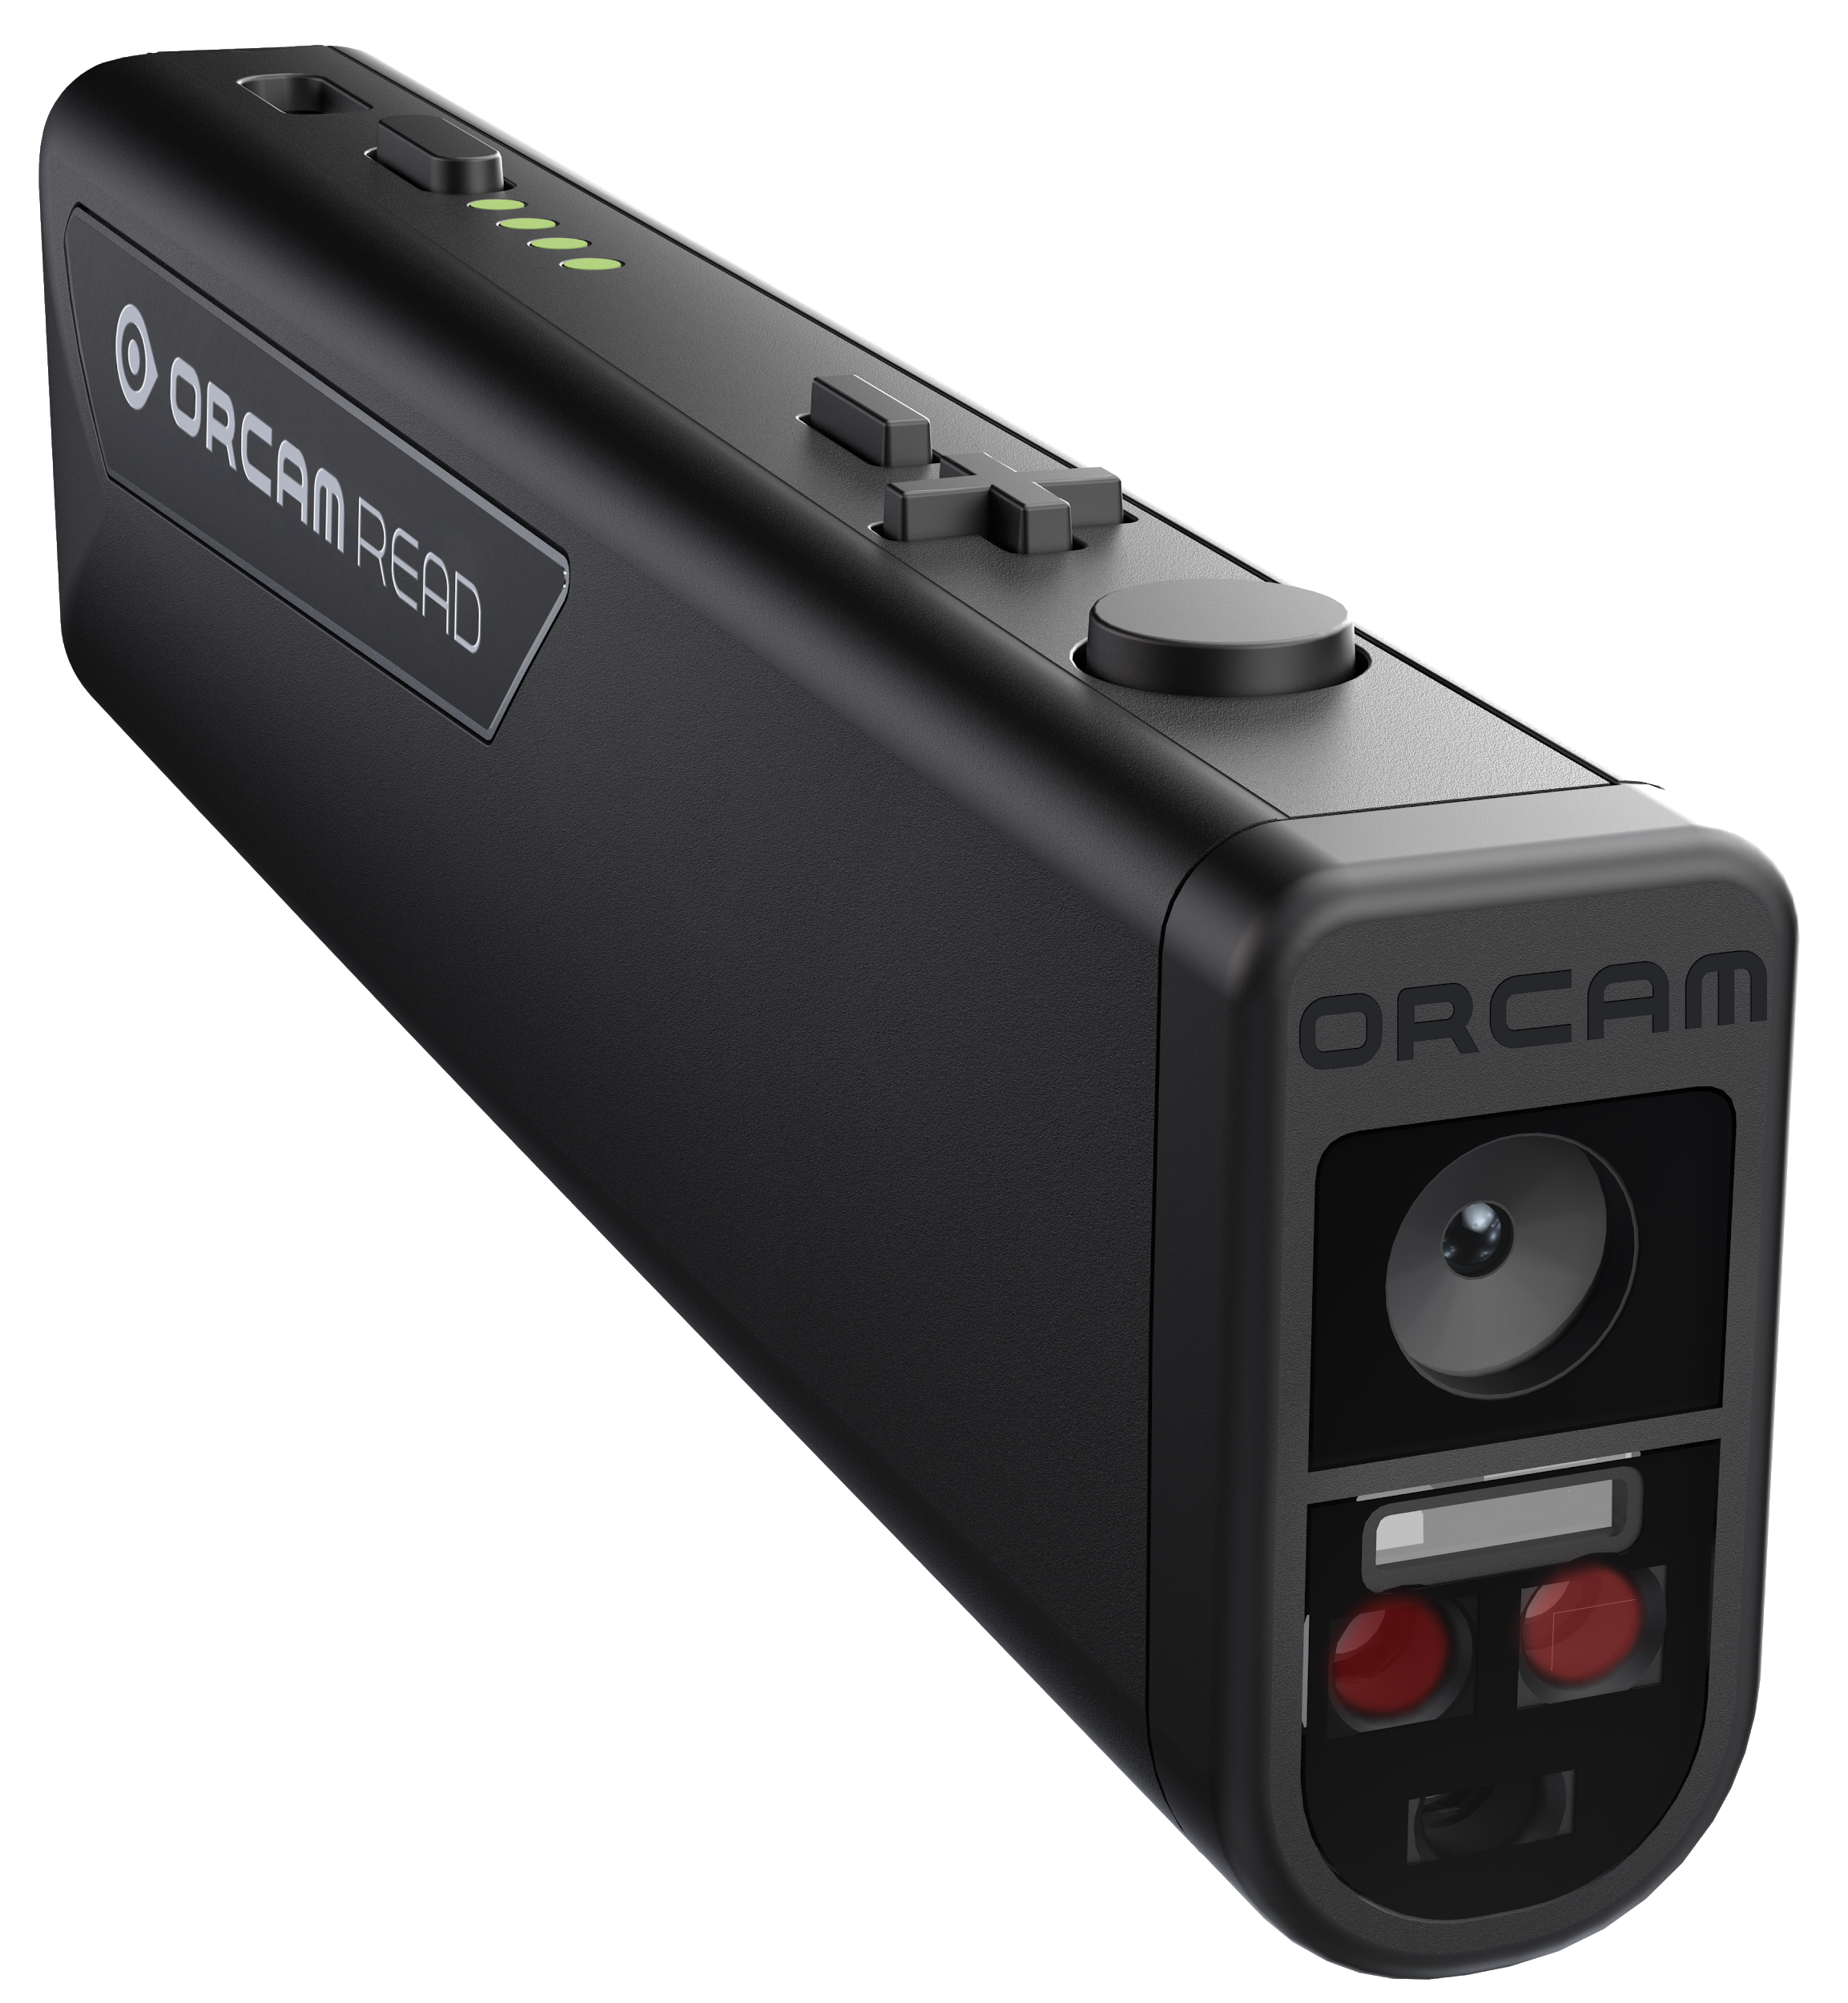
Handheld
OrCam Read.
Handheld reading without limitations.
Point-and-click activates laser guidance options, captures full pages/screens, operates offline
& in real time
*OrCam MIX scheduled for release in June
| May 2020
| 2020 | Create Your MIX
Notes:
The Choice is Yours.
A Powerful Solution.
Assistive AI unlike Anything Else.
Personal AI Technology. Life-changing Impact.

Slide 12
Our Features.
New!
New!
Read Text
Smart Reading
Orientation
Additional Language
| 2020 | Create Your MIX

Slide 13
Our Features.
Recognize Faces
Recognize
Money
Identify
Products
Recognize
Colors
| 2020 | Create Your MIX

Slide 14
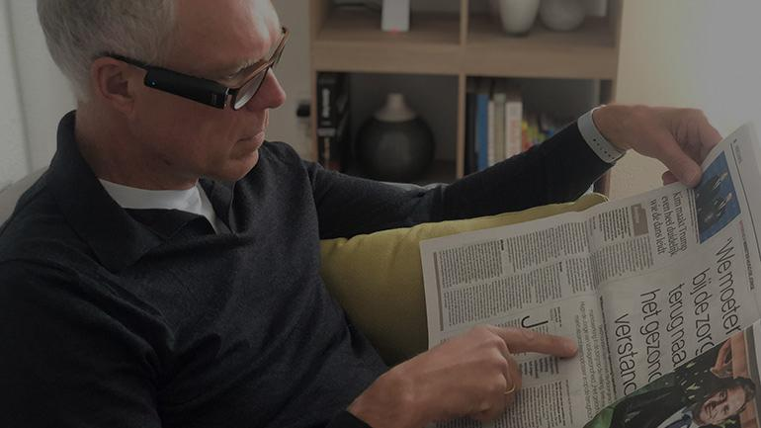
Smart Reading.
Empowers users to simply ask the device to retrieve and read the text that interests them, such as: newspaper headlines, specific menu items, and the total of a phone bill.
Watch

Slide 15
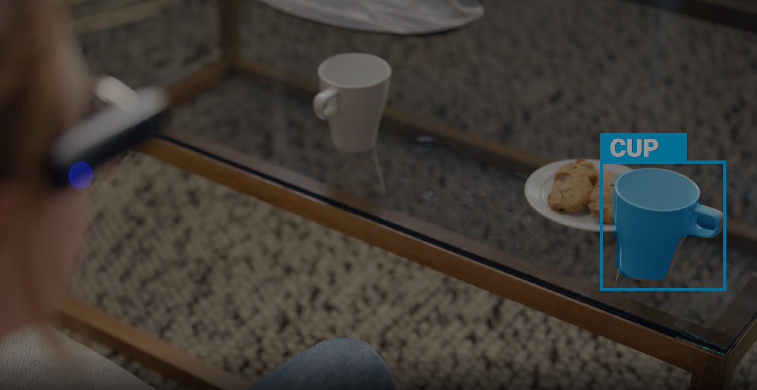
Orientation.*
Helps orient yourself by simply asking what is in your immediate surroundings, as well as for guidance.
(*Beta version)
Watch

Slide 16
Who can benefit from our products?

Slide 17
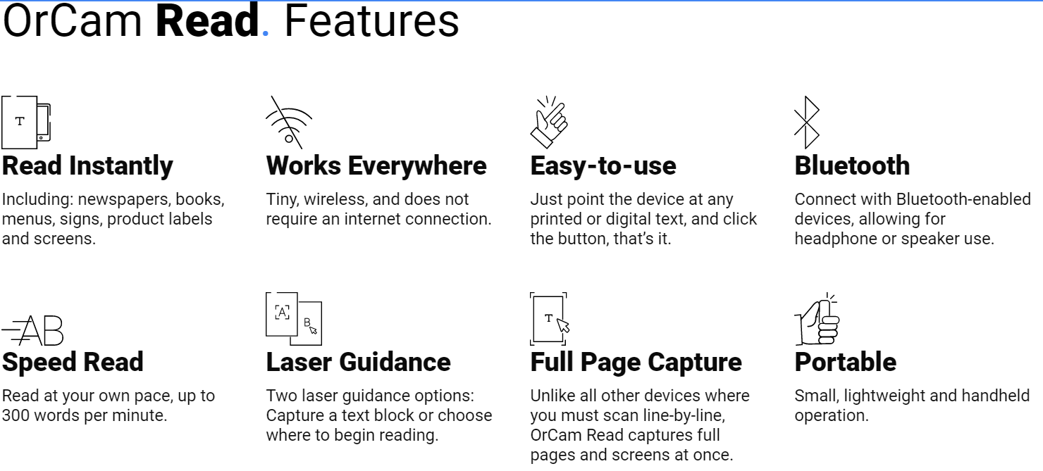
What is the OrCam Read?

Slide 18
Smart Reading & Languages
OrCam Read is available here in the US in 6 languages: English, Spanish, French, German, Italian and Portuguese
Smart reading available for now in 4 of them: English, Spanish, French, German
Smart Reading – Simply ask for the text that interests you

Slide 19
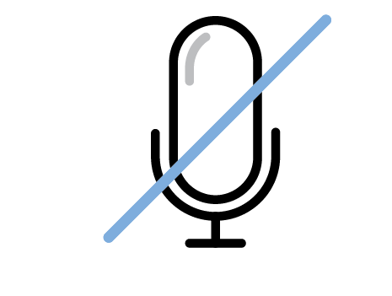
Privacy.
OrCam respects and protects your privacy
Does not record photos or videos
Stand-alone unit and does not send data to a cloud
Data is never collected by OrCam and is only available for your personal use
Nothing sent
to the cloud
No images or
videos saved
No audio
recording

Slide 20
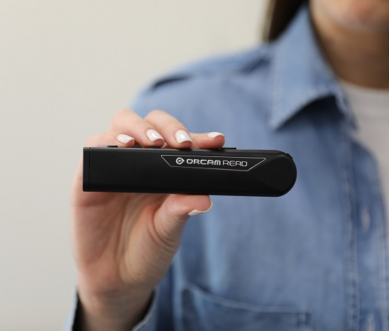
Questions?
Oded Tsin
oded.tsin@orcam.com
www.orcam.com

